Slide 1


Authentication in Angular
Jacob Wenger / @_jwngr
AngularJS Meetup / June 15 & 16, 2015

Slide 2
Goal
Authentication sucks and is difficult...

Slide 3
Goal
Authentication sucks and is difficult...
...but not for you!

Slide 4
Authentication Sucks!

Slide 5
Authentication Sucks!
Requires your own server

Slide 6
Authentication Sucks!
Requires your own server
User management is tedious

Slide 7
Authentication Sucks!
Requires your own server
User management is tedious
Myriad OAuth implementations

Slide 8
Authentication Sucks!
Requires your own server
User management is tedious
Myriad OAuth implementations
Security is hard

Slide 9
Authentication Sucks!
Requires your own server
User management is tedious
Myriad OAuth implementations
Security is hard
Offline is harder

Slide 10


Cookie-based Auth
Client
Server

Slide 11
Cookie-based Auth
1 / credentials
Client
Server

Slide 12
Cookie-based Auth
1 / credentials
2 / create session
Client
Server

Slide 13
Cookie-based Auth
1 / credentials
2 / create session
3 / cookie
Client
Server

Slide 14
Cookie-based Auth
1 / credentials
2 / create session
3 / cookie
4 / req w/ cookie
Client
Server

Slide 15
Cookie-based Auth
1 / credentials
2 / create session
3 / cookie
4 / req w/ cookie
5 / look up session;
verify cookie
Client
Server

Slide 16
Cookie-based Auth
1 / credentials
2 / create session
3 / cookie
4 / req w/ cookie
5 / look up session;
verify cookie
6 / response
Client
Server

Slide 17
Cookie-based Auth Flaws

Slide 18
Cookie-based Auth Flaws
Requires stateful servers

Slide 19
Cookie-based Auth Flaws
Requires stateful servers
Requires server lookup

Slide 20
Cookie-based Auth Flaws
Requires stateful servers
Requires server lookup
Limited to one domain

Slide 21
Cookie-based Auth Flaws
Requires stateful servers
Requires server lookup
Limited to one domain
Susceptible to CSRF

Slide 22
Cookie-based Auth Flaws
Requires stateful servers
Requires server lookup
Limited to one domain
Susceptible to CSRF
Lack of mobile support

Slide 23
JSON Web Tokens (JWTs)

Slide 24
JSON Web Tokens (JWTs)
eyJ0eXAiOiJKV1QiLCJhbGciOiJIUzI1
NiJ9.eyJ2IjowLCJkIjp7InVpZCI6ImFu
b255bW91czotSnJRcXhESThMX2ZCL
VFndnVjbiIsInByb3ZpZGVyIjoiYW5vbn
ltb3VzIn0sImlhdCI6MTQzMzkxMjcyNX
0.L9G282A3G6qgAds3YWEFzdX4olcyT
z_S9q9ptJSH0T_nc

Slide 25
JSON Web Tokens (JWTs)
{
"typ": "JWT",
"alg": "HS256"
}
eyJ0eXAiOiJKV1QiLCJhbGciOiJIUzI1
NiJ9.eyJ2IjowLCJkIjp7InVpZCI6ImFu
b255bW91czotSnJRcXhESThMX2ZCL
VFndnVjbiIsInByb3ZpZGVyIjoiYW5vbn
ltb3VzIn0sImlhdCI6MTQzMzkxMjcyNX
0.L9G282A3G6qgAds3YWEFzdX4olcyT
z_S9q9ptJSH0T_nc

Slide 26
JSON Web Tokens (JWTs)
{
"typ": "JWT",
"alg": "HS256"
}
{
"sub": "jwngr",
"exp": 1433913414641
}
eyJ0eXAiOiJKV1QiLCJhbGciOiJIUzI1
NiJ9.eyJ2IjowLCJkIjp7InVpZCI6ImFu
b255bW91czotSnJRcXhESThMX2ZCL
VFndnVjbiIsInByb3ZpZGVyIjoiYW5vbn
ltb3VzIn0sImlhdCI6MTQzMzkxMjcyNX
0.L9G282A3G6qgAds3YWEFzdX4olcyT
z_S9q9ptJSH0T_nc

Slide 27
JSON Web Tokens (JWTs)
{
"typ": "JWT",
"alg": "HS256"
}
{
"sub": "jwngr",
"exp": 1433913414641
}
HMACSHA256(base64(header) + base64(payload) + secret);
eyJ0eXAiOiJKV1QiLCJhbGciOiJIUzI1
NiJ9.eyJ2IjowLCJkIjp7InVpZCI6ImFu
b255bW91czotSnJRcXhESThMX2ZCL
VFndnVjbiIsInByb3ZpZGVyIjoiYW5vbn
ltb3VzIn0sImlhdCI6MTQzMzkxMjcyNX
0.L9G282A3G6qgAds3YWEFzdX4olcyT
z_S9q9ptJSH0T_nc

Slide 28
JSON Web Tokens (JWTs)

Slide 29
JSON Web Tokens (JWTs)
Not encrypted

Slide 30
JSON Web Tokens (JWTs)
Not encrypted
Claims contains custom data

Slide 31
JSON Web Tokens (JWTs)
Not encrypted
Claims contains custom data
Stored in local storage

Slide 32
JSON Web Tokens (JWTs)
Not encrypted
Claims contains custom data
Stored in local storage
Server generates and validates JWTs

Slide 33
Generating JWTs
var jwt = new JWT("<SECRET>");
var token = jwt.generateToken({
some: "arbitrary",
data: "here"
});

Slide 34
Generating JWTs
var jwt = new JWT("<SECRET>");
var token = jwt.generateToken({
some: "arbitrary",
data: "here"
});

Slide 35
Generating JWTs
var jwt = new JWT("<SECRET>");
var token = jwt.generateToken({
some: "arbitrary",
data: "here"
});

Slide 36
Generating JWTs
var jwt = new JWT("<SECRET>");
var token = jwt.generateToken({
some: "arbitrary",
data: "here"
});

Slide 37
Generating JWTs
eyJ0eXAiOiJKV1QiLCJhbGciOiJIUzI1NiJ9.eyJ2IjowLCJkIjp7InVpZCI6ImFub255bW91czotSnJRcXhESThMX2ZCLVFndnVjbiIsInByb3ZpZGVyIjoiYW5vbn...
var jwt = new JWT("<SECRET>");
var token = jwt.generateToken({
some: "arbitrary",
data: "here"
});

Slide 38
Validating JWTs
var jwt = new JWT("<SECRET>");
var data = jwt.decodeToken(token).claims;

Slide 39
Validating JWTs
var jwt = new JWT("<SECRET>");
var data = jwt.decodeToken(token).claims;

Slide 40
Validating JWTs
var jwt = new JWT("<SECRET>");
var data = jwt.decodeToken(token).claims;

Slide 41
Validating JWTs
var jwt = new JWT("<SECRET>");
var data = jwt.decodeToken(token).claims;

Slide 42
Validating JWTs
var jwt = new JWT("<SECRET>");
var data = jwt.decodeToken(token).claims;
{ some: "arbitrary", data: "here" }

Slide 43
JWT-based Auth
Client
Server

Slide 44
JWT-based Auth
1 / credentials
Client
Server

Slide 45
JWT-based Auth
1 / credentials
2 / generate JWT
Client
Server

Slide 46
JWT-based Auth
1 / credentials
2 / generate JWT
3 / JWT
Client
Server

Slide 47
JWT-based Auth
1 / credentials
2 / generate JWT
3 / JWT
4 / req w/ JWT
Client
Server

Slide 48
JWT-based Auth
1 / credentials
2 / generate JWT
3 / JWT
4 / req w/ JWT
5 / decode JWT;
verify JWT
Client
Server

Slide 49
JWT-based Auth
1 / credentials
2 / generate JWT
3 / JWT
4 / req w/ JWT
5 / decode JWT;
verify JWT
6 / response
Client
Server

Slide 50
Why JWTs?

Slide 51
Why JWTs?
State is kept on the client, not the server

Slide 52
Why JWTs?
State is kept on the client, not the server
Work across multiple domains

Slide 53
Why JWTs?
State is kept on the client, not the server
Work across multiple domains
Work just as well on mobile as they do on web

Slide 54
Why JWTs?
State is kept on the client, not the server
Work across multiple domains
Work just as well on mobile as they do on web
Generated / validated by anyone with the secret

Slide 55
Why JWTs?
State is kept on the client, not the server
Work across multiple domains
Work just as well on mobile as they do on web
Generated / validated by anyone with the secret
Susceptible to XSS (so be careful!)

Slide 56
JWTs FTW

Slide 57
JWTs FTW
So JWTs are great and all…

Slide 58
JWTs FTW?
So JWTs are great and all…
… but how do get the data to put in them?

Slide 59
Why Is Auth Hard?

Slide 60
Why Is Auth Hard?
Need server to generate JWTs

Slide 61
Why Is Auth Hard?
Need server to generate JWTs
Need database to store users

Slide 62
Why Is Auth Hard?
Need server to generate JWTs
Need database to store users
Storing passwords is tricky

Slide 63
Why Is Auth Hard?
Need server to generate JWTs
Need database to store users
Storing passwords is tricky
OAuth is a nightmare...

Slide 64
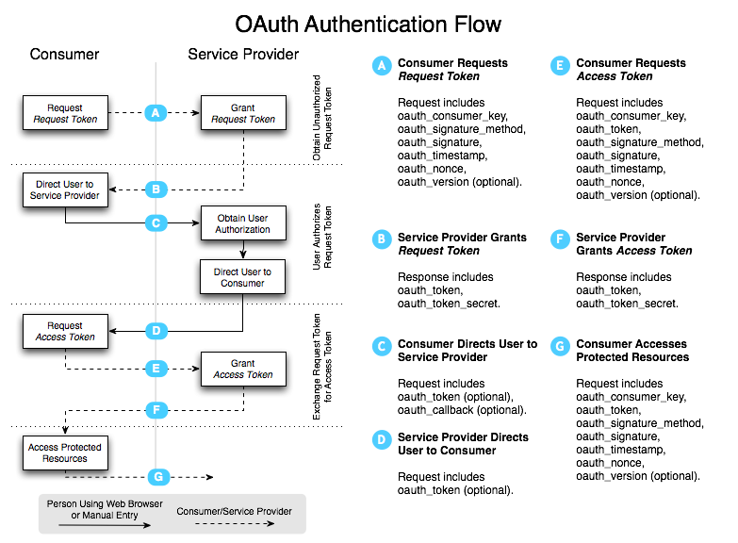
http://p2p.wrox.com/content/sites/default/files/users/17/image/figures%20ch6/531327%20f0602.png

Slide 65
Wut?
http://p2p.wrox.com/content/sites/default/files/users/17/image/figures%20ch6/531327%20f0602.png

Slide 66
Firebase
A powerful platform for
building extraordinary apps

Slide 67
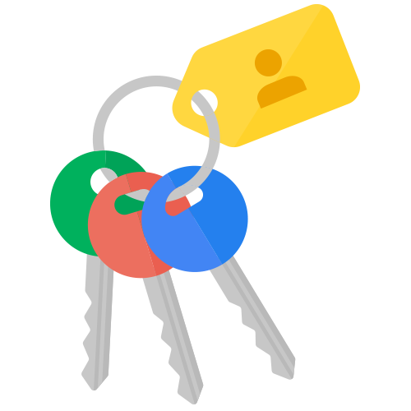

Firebase Is Your Backend
Realtime Database
Authentication
Hosting

Slide 68

Cross-platform SDKs

Slide 69
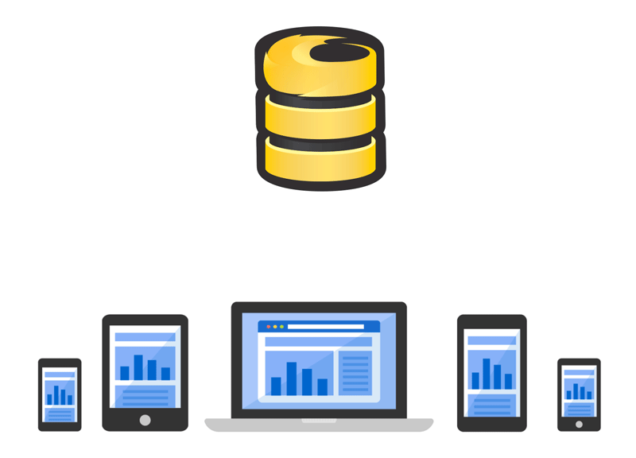
Realtime Sync

Slide 70
Authentication

Slide 71
Authentication
JWT-based authentication

Slide 72
Authentication
JWT-based authentication
No server required

Slide 73
Authentication
JWT-based authentication
No server required
Many auth types (anonymous, email, OAuth, etc.)

Slide 74
Authentication
JWT-based authentication
No server required
Many auth types (anonymous, email, OAuth, etc.)
Custom auth if you want to make your own JWTs

Slide 75
Authentication
JWT-based authentication
No server required
Many auth types (anonymous, email, OAuth, etc.)
Custom auth if you want to make your own JWTs
Works offline

Slide 76
Authenticating Users
var ref = new Firebase("https://ng-auth.firebaseio.com");
ref.authWithPassword({
email: "foo@bar.com",
password: "correcthorsebatterystaple"
}, function(error, authData) {
// User authenticated
});

Slide 77
Authenticating Users
var ref = new Firebase("https://ng-auth.firebaseio.com");
ref.authWithPassword({
email: "foo@bar.com",
password: "correcthorsebatterystaple"
}, function(error, authData) {
// User authenticated
});

Slide 78
Authenticating Users
var ref = new Firebase("https://ng-auth.firebaseio.com");
ref.authWithPassword({
email: "foo@bar.com",
password: "correcthorsebatterystaple"
}, function(error, authData) {
// User authenticated
});

Slide 79
Authenticating Users
var ref = new Firebase("https://ng-auth.firebaseio.com");
ref.authWithPassword({
email: "foo@bar.com",
password: "correcthorsebatterystaple"
}, function(error, authData) {
// User authenticated
});

Slide 80
Authenticating Users
var ref = new Firebase("https://ng-auth.firebaseio.com");
ref.authWithPassword({
email: "foo@bar.com",
password: "correcthorsebatterystaple"
}, function(error, authData) {
// User authenticated
});

Slide 81
Detecting Auth State
var ref = new Firebase("https://ng-auth.firebaseio.com");
ref.onAuth(function(authData) {
if (authData) {
// User logged in
} else {
// User logged out
}
});

Slide 82
Detecting Auth State
var ref = new Firebase("https://ng-auth.firebaseio.com");
ref.onAuth(function(authData) {
if (authData) {
// User logged in
} else {
// User logged out
}
});

Slide 83
Detecting Auth State
var ref = new Firebase("https://ng-auth.firebaseio.com");
ref.onAuth(function(authData) {
if (authData) {
// User logged in
} else {
// User logged out
}
});

Slide 84
Detecting Auth State
var ref = new Firebase("https://ng-auth.firebaseio.com");
ref.onAuth(function(authData) {
if (authData) {
// User logged in
} else {
// User logged out
}
});

Slide 85
Detecting Auth State
var ref = new Firebase("https://ng-auth.firebaseio.com");
ref.onAuth(function(authData) {
if (authData) {
// User logged in
} else {
// User logged out
}
});

Slide 86
Detecting Auth State
var ref = new Firebase("https://ng-auth.firebaseio.com");
ref.onAuth(function(authData) {
if (authData) {
// User logged in
} else {
// User logged out
}
});

Slide 87
Creating Users
var ref = new Firebase("https://ng-auth.firebaseio.com");
ref.createUser({
email: "foo@bar.com",
password: "correcthorsebatterystaple"
}, function(error, userData) {
// User created
});

Slide 88
Creating Users
var ref = new Firebase("https://ng-auth.firebaseio.com");
ref.createUser({
email: "foo@bar.com",
password: "correcthorsebatterystaple"
}, function(error, userData) {
// User created
});

Slide 89
Creating Users
var ref = new Firebase("https://ng-auth.firebaseio.com");
ref.createUser({
email: "foo@bar.com",
password: "correcthorsebatterystaple"
}, function(error, userData) {
// User created
});

Slide 90
Creating Users
var ref = new Firebase("https://ng-auth.firebaseio.com");
ref.createUser({
email: "foo@bar.com",
password: "correcthorsebatterystaple"
}, function(error, userData) {
// User created
});

Slide 91
Creating Users
var ref = new Firebase("https://ng-auth.firebaseio.com");
ref.createUser({
email: "foo@bar.com",
password: "correcthorsebatterystaple"
}, function(error, userData) {
// User created
});

Slide 92
Better Together

Slide 93
AngularFire
AngularFire provides a set of services to
bind data between Firebase and Angular and to authenticate and manage users.

Slide 94
AngularFire Services

Slide 95
AngularFire Services
$firebaseArray - synchronized collections

Slide 96
AngularFire Services
$firebaseArray - synchronized collections
$firebaseObject - synchronized objects

Slide 97
AngularFire Services
$firebaseArray - synchronized collections
$firebaseObject - synchronized objects
$firebaseAuth - authentication, user management, routing

Slide 98
$firebaseAuth
var app = angular.module("app", ["firebase"]);
app.controller("Ctrl", function($scope, $firebaseAuth) {
var ref = new Firebase("https://...");
$scope.authObj = $firebaseAuth(ref);
// ...
});

Slide 99
$firebaseAuth
var app = angular.module("app", ["firebase"]);
app.controller("Ctrl", function($scope, $firebaseAuth) {
var ref = new Firebase("https://...");
$scope.authObj = $firebaseAuth(ref);
// ...
});

Slide 100
$firebaseAuth
var app = angular.module("app", ["firebase"]);
app.controller("Ctrl", function($scope, $firebaseAuth) {
var ref = new Firebase("https://...");
$scope.authObj = $firebaseAuth(ref);
// ...
});

Slide 101
$firebaseAuth
var app = angular.module("app", ["firebase"]);
app.controller("Ctrl", function($scope, $firebaseAuth) {
var ref = new Firebase("https://...");
$scope.authObj = $firebaseAuth(ref);
// ...
});

Slide 102
$firebaseAuth
var app = angular.module("app", ["firebase"]);
app.controller("Ctrl", function($scope, $firebaseAuth) {
var ref = new Firebase("https://...");
$scope.authObj = $firebaseAuth(ref);
// ...
});

Slide 103
Authenticating Users
$scope.authObj.$authWithPassword({
email: "foo@bar.com",
password: "correcthorsebatterystaple"
}).then(function(authData) {
// User authenticated
}).catch(function(error) {
// Authentication error
});

Slide 104
Authenticating Users
$scope.authObj.$authWithPassword({
email: "foo@bar.com",
password: "correcthorsebatterystaple"
}).then(function(authData) {
// User authenticated
}).catch(function(error) {
// Authentication error
});

Slide 105
Authenticating Users
$scope.authObj.$authWithPassword({
email: "foo@bar.com",
password: "correcthorsebatterystaple"
}).then(function(authData) {
// User authenticated
}).catch(function(error) {
// Authentication error
});

Slide 106
Authenticating Users
$scope.authObj.$authWithPassword({
email: "foo@bar.com",
password: "correcthorsebatterystaple"
}).then(function(authData) {
// User authenticated
}).catch(function(error) {
// Authentication error
});

Slide 107
Authenticating Users
$scope.authObj.$authWithPassword({
email: "foo@bar.com",
password: "correcthorsebatterystaple"
}).then(function(authData) {
// User authenticated
}).catch(function(error) {
// Authentication error
});

Slide 108
Detecting Auth State
$scope.authObj.$onAuth(function(authData) {
if (authData) {
// User logged in
} else {
// User logged out
}
});

Slide 109
Detecting Auth State
$scope.authObj.$onAuth(function(authData) {
if (authData) {
// User logged in
} else {
// User logged out
}
});

Slide 110
Detecting Auth State
$scope.authObj.$onAuth(function(authData) {
if (authData) {
// User logged in
} else {
// User logged out
}
});

Slide 111
Detecting Auth State
$scope.authObj.$onAuth(function(authData) {
if (authData) {
// User logged in
} else {
// User logged out
}
});

Slide 112
Detecting Auth State
$scope.authObj.$onAuth(function(authData) {
if (authData) {
// User logged in
} else {
// User logged out
}
});

Slide 113
Creating Users
$scope.authObj.ref.$createUser({
email: "foo@bar.com",
password: "correcthorsebatterystaple"
}).then(function(userData) {
// User created
}).catch(function(error) {
// Error creating user
});

Slide 114
Creating Users
$scope.authObj.ref.$createUser({
email: "foo@bar.com",
password: "correcthorsebatterystaple"
}).then(function(userData) {
// User created
}).catch(function(error) {
// Error creating user
});

Slide 115
Creating Users
$scope.authObj.ref.$createUser({
email: "foo@bar.com",
password: "correcthorsebatterystaple"
}).then(function(userData) {
// User created
}).catch(function(error) {
// Error creating user
});

Slide 116
Creating Users
$scope.authObj.ref.$createUser({
email: "foo@bar.com",
password: "correcthorsebatterystaple"
}).then(function(userData) {
// User created
}).catch(function(error) {
// Error creating user
});

Slide 117
Creating Users
$scope.authObj.ref.$createUser({
email: "foo@bar.com",
password: "correcthorsebatterystaple"
}).then(function(userData) {
// User created
}).catch(function(error) {
// Error creating user
});

Slide 118
Route-based Security

Slide 119
Route-based Security
Helper promises for use in resolve()

Slide 120
Route-based Security
Helper promises for use in resolve()
$waitForAuth()

Slide 121
Route-based Security
Helper promises for use in resolve()
$waitForAuth()
$requireAuth()

Slide 122
Route-based Security
Helper promises for use in resolve()
$waitForAuth()
$requireAuth()
Works with ngRoute and ui-router

Slide 123
ngRoute
$routeProvider.when("/account", {
controller: "AccountCtrl",
templateUrl: "views/account.html",
resolve: {
currentAuth: function(Auth) {
return Auth.$waitForAuth();
}
}
});

Slide 124
ngRoute
$routeProvider.when("/account", {
controller: "AccountCtrl",
templateUrl: "views/account.html",
resolve: {
currentAuth: function(Auth) {
return Auth.$waitForAuth();
}
}
});

Slide 125
ui-router
$stateProvider.state("/account", {
controller: "AccountCtrl",
templateUrl: "views/account.html",
resolve: {
currentAuth: function(Auth) {
return Auth.$waitForAuth();
}
}
});

Slide 126
ui-router
$stateProvider.state("/account", {
controller: "AccountCtrl",
templateUrl: "views/account.html",
resolve: {
currentAuth: function(Auth) {
return Auth.$waitForAuth();
}
}
});

Slide 127
ui-router
$stateProvider.state("/account", {
controller: "AccountCtrl",
templateUrl: "views/account.html",
resolve: {
currentAuth: function(Auth) {
return Auth.$waitForAuth();
}
}
});

Slide 128
ui-router
$stateProvider.state("/account", {
controller: "AccountCtrl",
templateUrl: "views/account.html",
resolve: {
currentAuth: function(Auth) {
return Auth.$waitForAuth();
}
}
});

Slide 129
Live
Coding

Slide 130
Try The Demo
https://ng-auth.firebaseapp.com

Slide 131
Firebase Is Your Backend
Realtime Database
Authentication
Hosting

Slide 132
Get Started Now!
firebase.com/docs
firebase.com/tutorial

Slide 133
Authentication in Angular
Jacob Wenger / @_jwngr
Firebase / @firebase
https://github.com/jwngr/ng-auth

